Slide 1
Real time traffic management :
A comprehensive IOT based solution and public safety

Slide 2
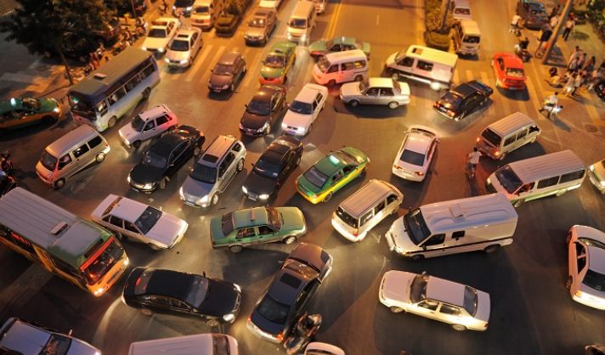
Introduction
One of the most profound aftermaths of evolving technologies in this modern era is rapidly increasing vehicular counts, which has become grave in the wake of staggering rise in world population. As a result, traffic congestion has become a serious problem in most countries around the world.
Traffic congestion can be caused by key factors such as accidents, traffic overload, construction and even pedestrians crossing the road incorrectly or holding up vehicles. In Tier 2 and Tier 3 cities, traffic congestion becomes worse due to bad roads, and poor connectivity among other factors.
Gridlock on junction due to heavy congestion

Slide 3
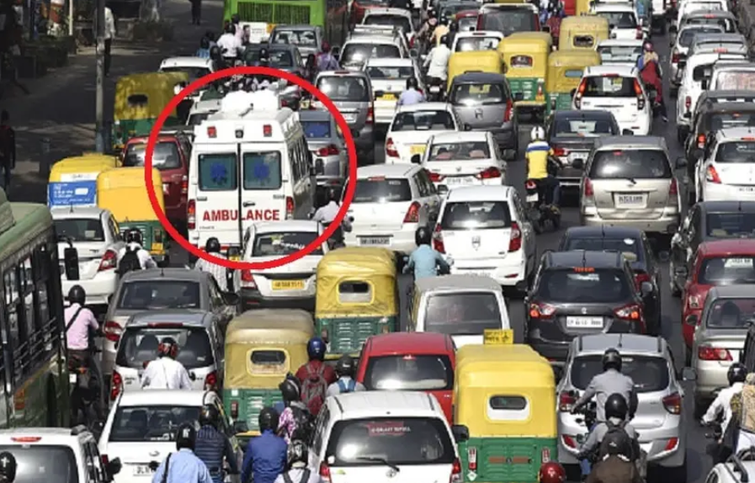
Due to increased traffic, there has been an increase in traffic jams, which has caused a problem for ambulances in moving patients to the appropriate destinations on time in case of emergency.
Statistically, it has been observed that more than 20% patients requiring urgent medical attention die on their way to the hospital because of delays.
The International Road Federation, Geneva Program Centre has reported 3,000 deaths everyday as a result of road accidents. This approximates to a yearly figure of 1.3 million and a total count of 2.4 million road accident deaths.
One of the identified reasons for deaths is delayed emergencies services and the ambulance unable to reach the accident location and then, to the hospital, in time. This is especially true in today’s urban environments where more and more types of transportation methods coexist.
Ambulance stuck in the traffic jam

Slide 4
Problem Statement & Objective
Problem statement:
One of the many problems that people living in metropolitian cities face on a daily basis is the problem of gridlock on roads. As a result of this many people lose their precious time sitting idle in long exhausting traffic jams. Therefore, fixed timings at signals may delay the traffic.
The problem of an ambulance not reaching its desired location is not being solved yet. So, in order to deal with this problem, we need a system, in which the ambulance does not need to stop anywhere on the way and can directly go to its destination.
Objectives:
To automatically control the traffic signaling based on the current congestion scenarios on the road using IR sensors
To enhance the speed of ambulance transport during heavy traffic situations to ensure timely delivery of life-saving medical assistance, we prioritize the emergency vehicles manually by changing the traffic signal to green with the help of Iot application.
To reach the concerned destination earlier, the emergency service will send the shortest path to the emergency driver using GSM module.
Indicating the public about the arrival of ambulance in the signal using LCD display

Slide 5
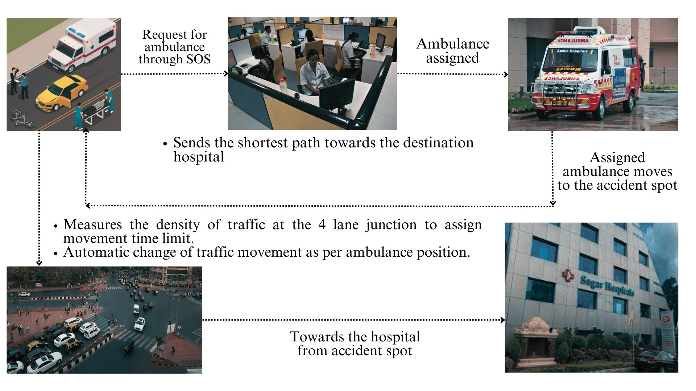
Flow Diagram

Slide 6
Methodology
Proposed traffic management system using IoT
1.) The system controls the density of traffic signals using an Arduino-based circuit system and sends the data to the controllers.
IR sensors, which are arranged at particular distances apart on each lane, transmit and sense the density.
The traffic lights are then manipulated systematically with different time delays for different densities.
The densities are measured at three levels
1. Low density - 10 seconds
2. High density - 15 seconds
By this way the time can be saved at the junction, in which the effects of traffic congestion and grid locks are overcomed.

Slide 7
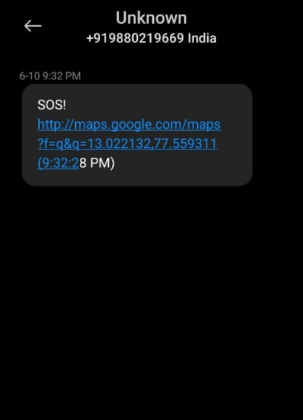
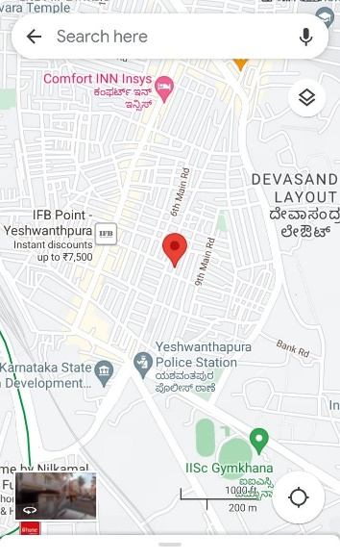
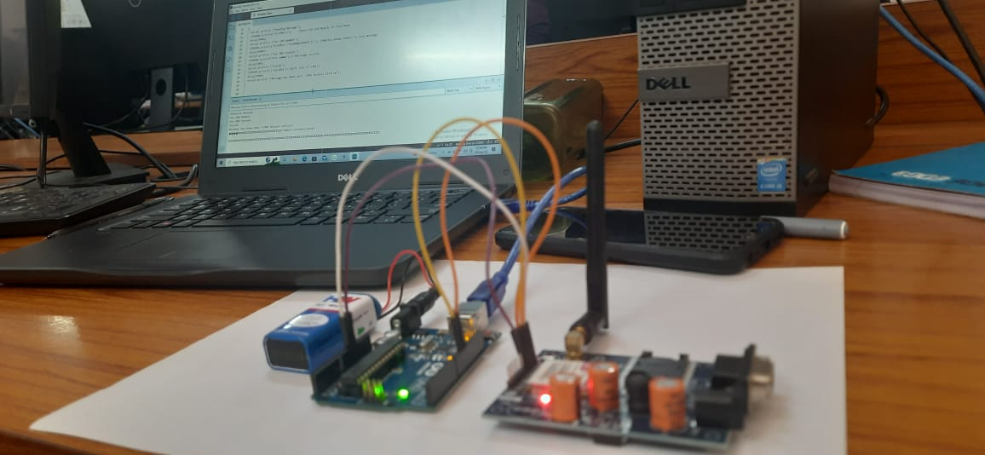
Methodology
2).When activated, this feature sends an emergency message ,including the accident location, to the ambulance service. This allows for immediate notification and quick response to the accident.
Upon receiving the SOS message, the ambulance service swings into action. They utilize the information provided in the distress signal to arrange and dispatch an emergency vehicle to the accident spot.
The ambulance service leverages navigation systems or GPS technology to determine the shortest and most optimal route from the accident spot to the hospital( i.e., Google Maps).
The ambulance would also be equipped with a GSM module, which enables communication between the ambulance driver and the ambulance service.

Slide 8
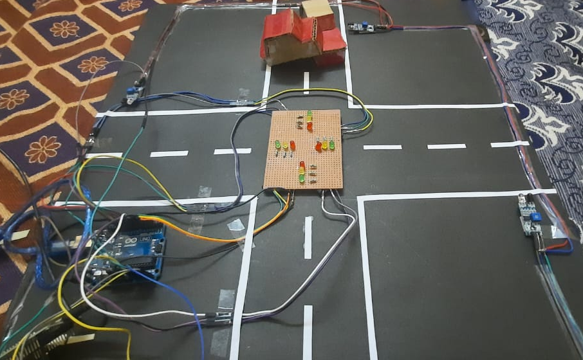
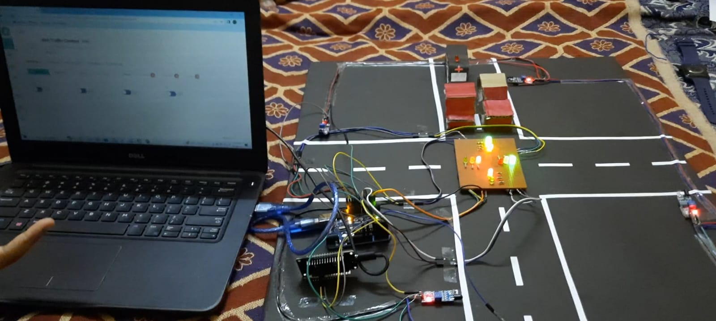
Methodology
3.) To enhance the speed of ambulance transport during heavy traffic situations, we prioritize the emergency vehicles manually by changing the traffic signal to green.
Here, the emergency vehicle will have an inbuilt system ( i.e Blynk App) in which the driver can switch ON the current lane, so that the lane will be green for the ambulance to move.
This traffic lights are controlled to prioritized a particular lane when a emergency vehicle arrives using Blynk App via a wifi Module (i.e ESP8266 Node Mcu)
Sudden accident in an road
Ambulance driver switching the current lane to green using IoT Application

Slide 9
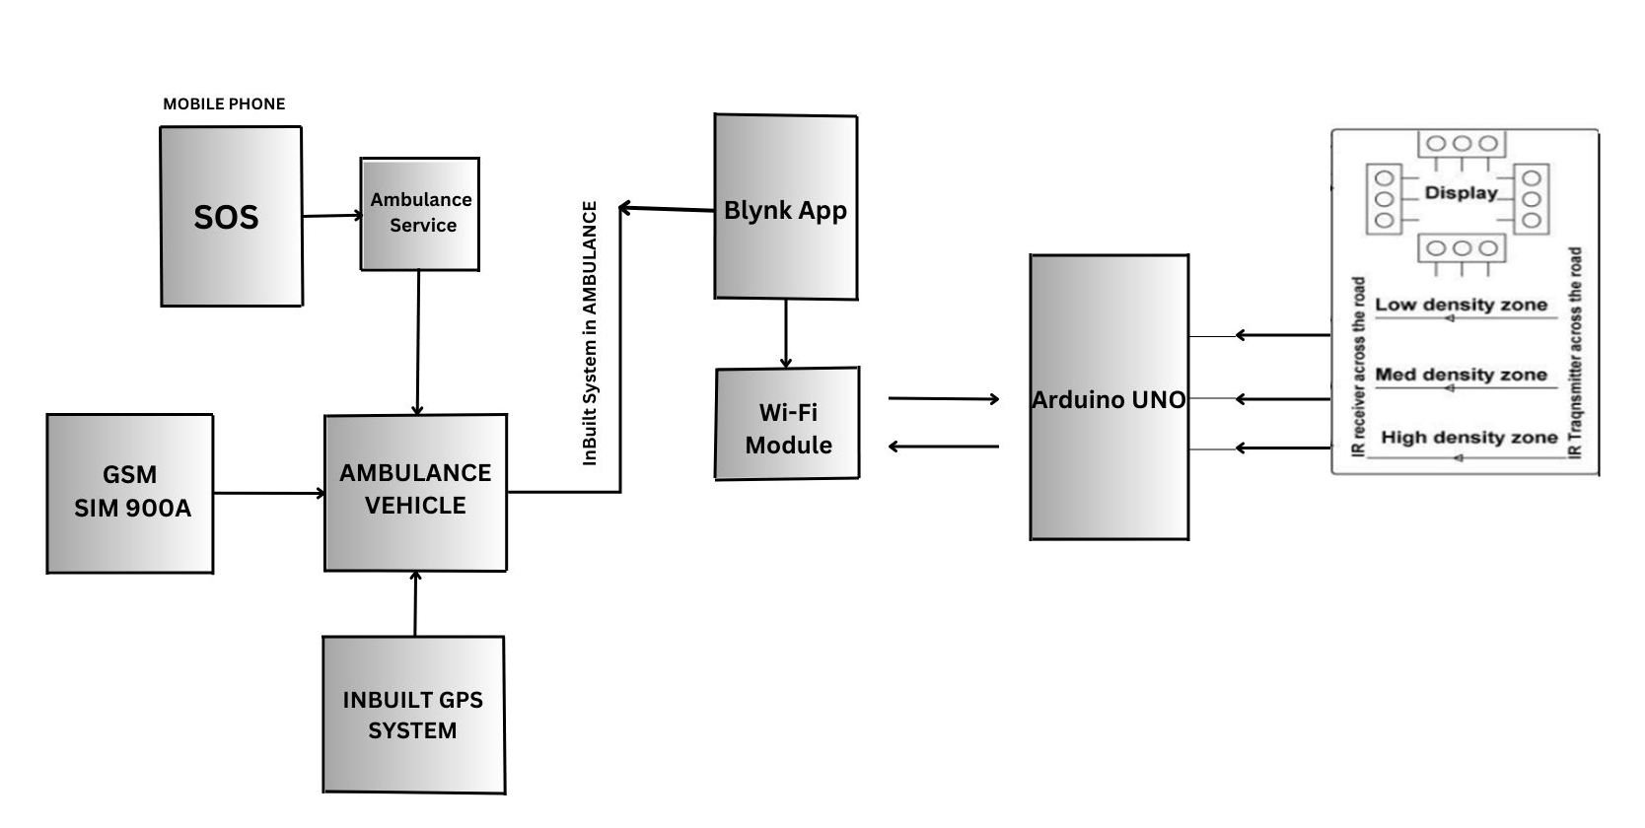
Block Diagram

Slide 10
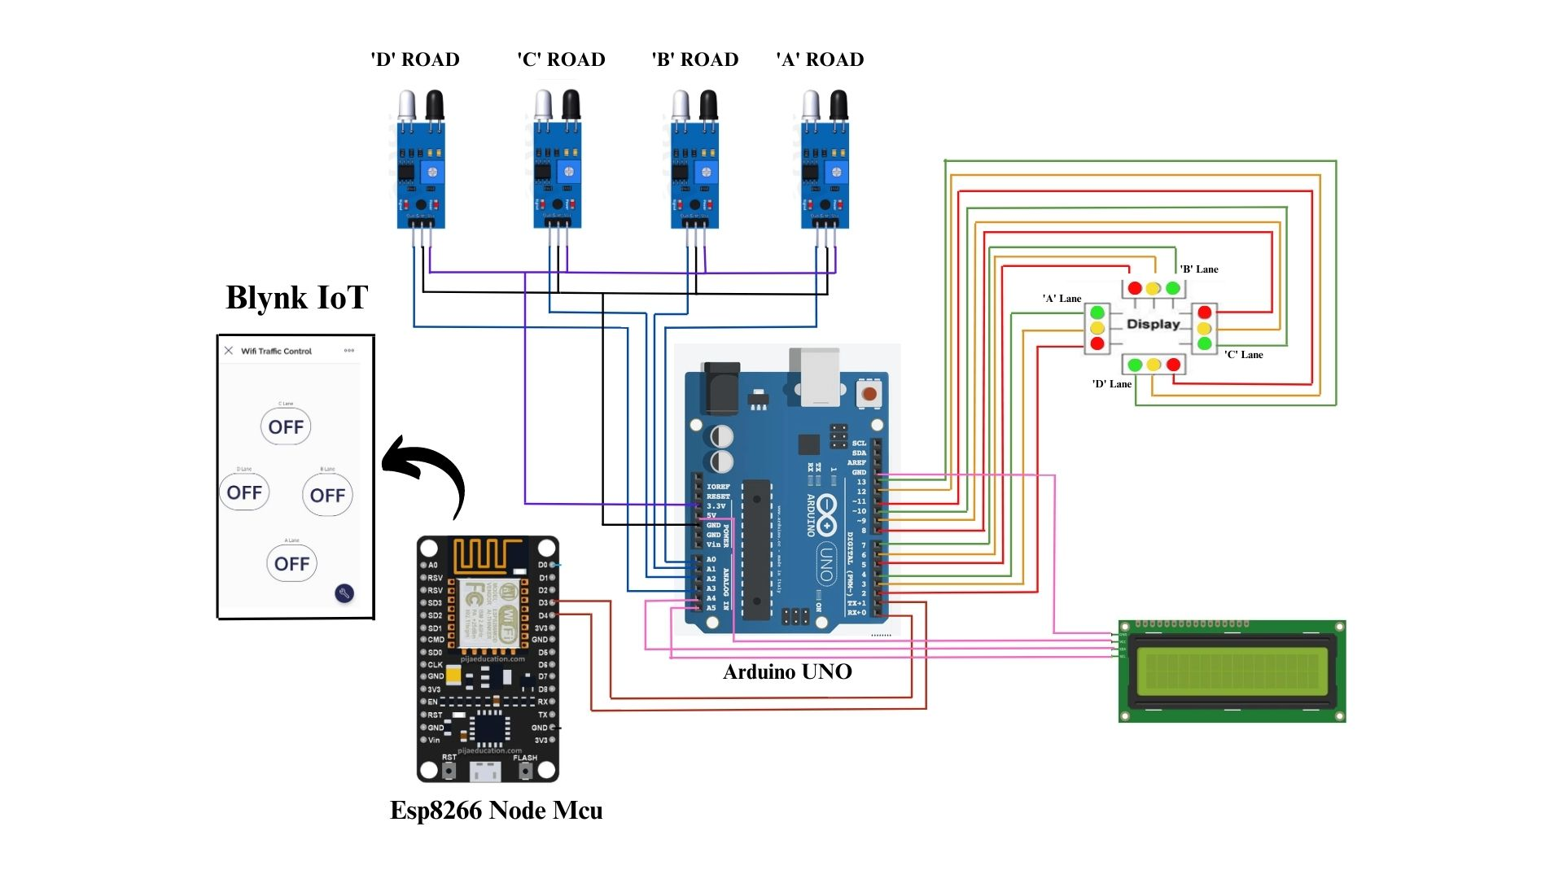
Circuit Diagram

Slide 11
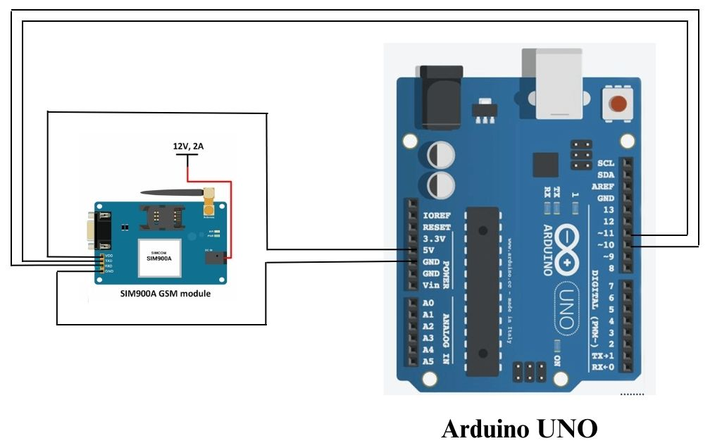
Circuit Diagram

Slide 12
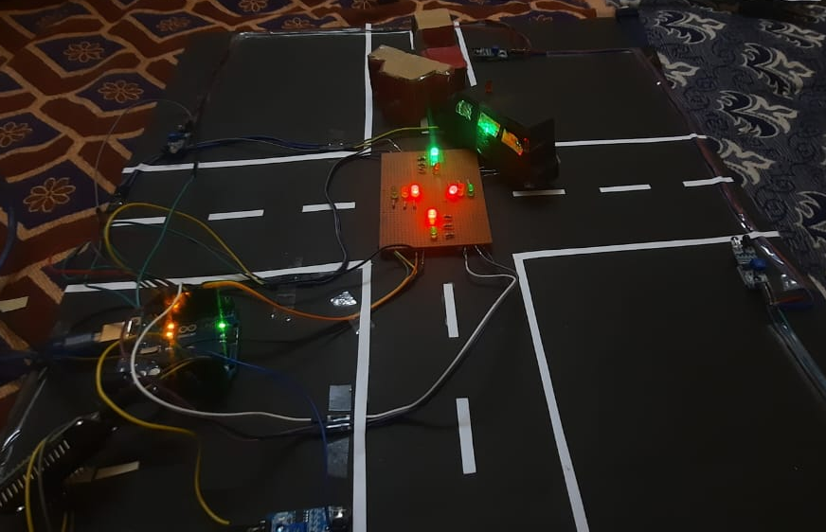
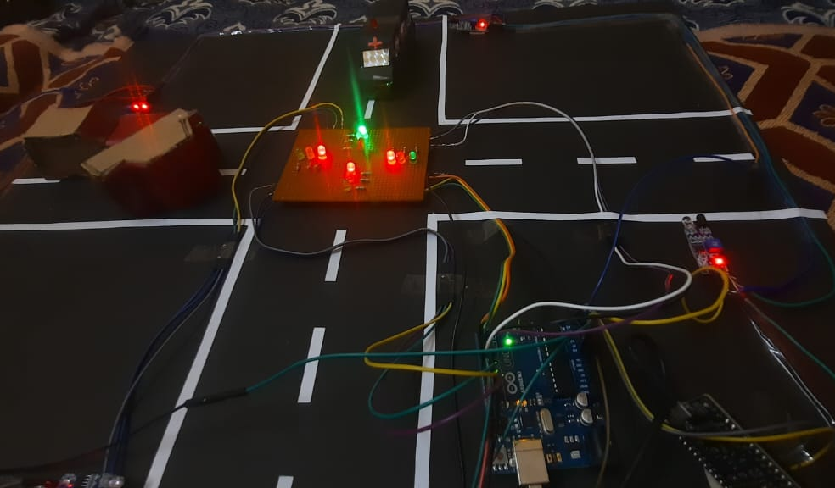
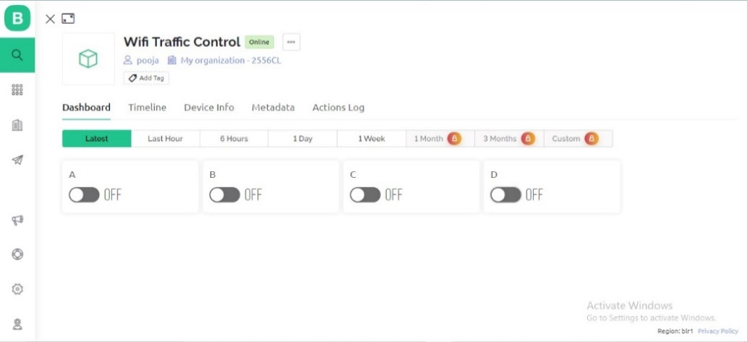
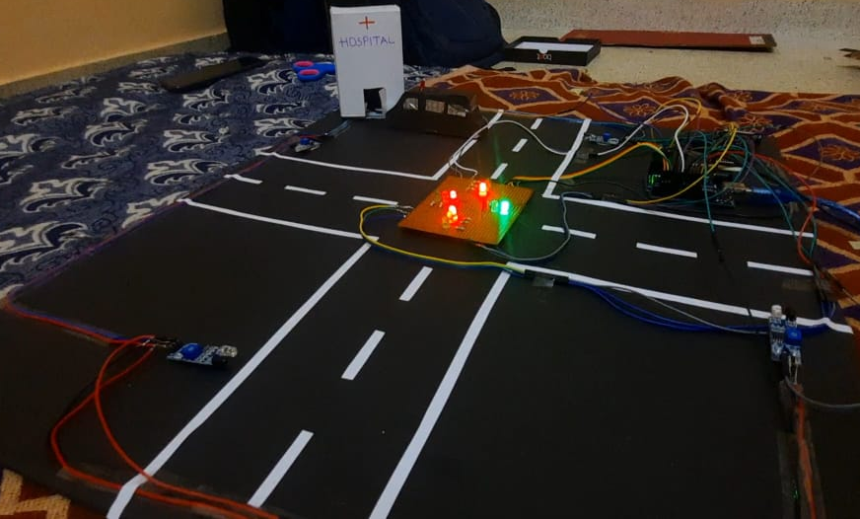
Results
Ambulance towards the accident Spot
Ambulance on the way to hospital
Reached the destination earliest without any delay

Slide 13
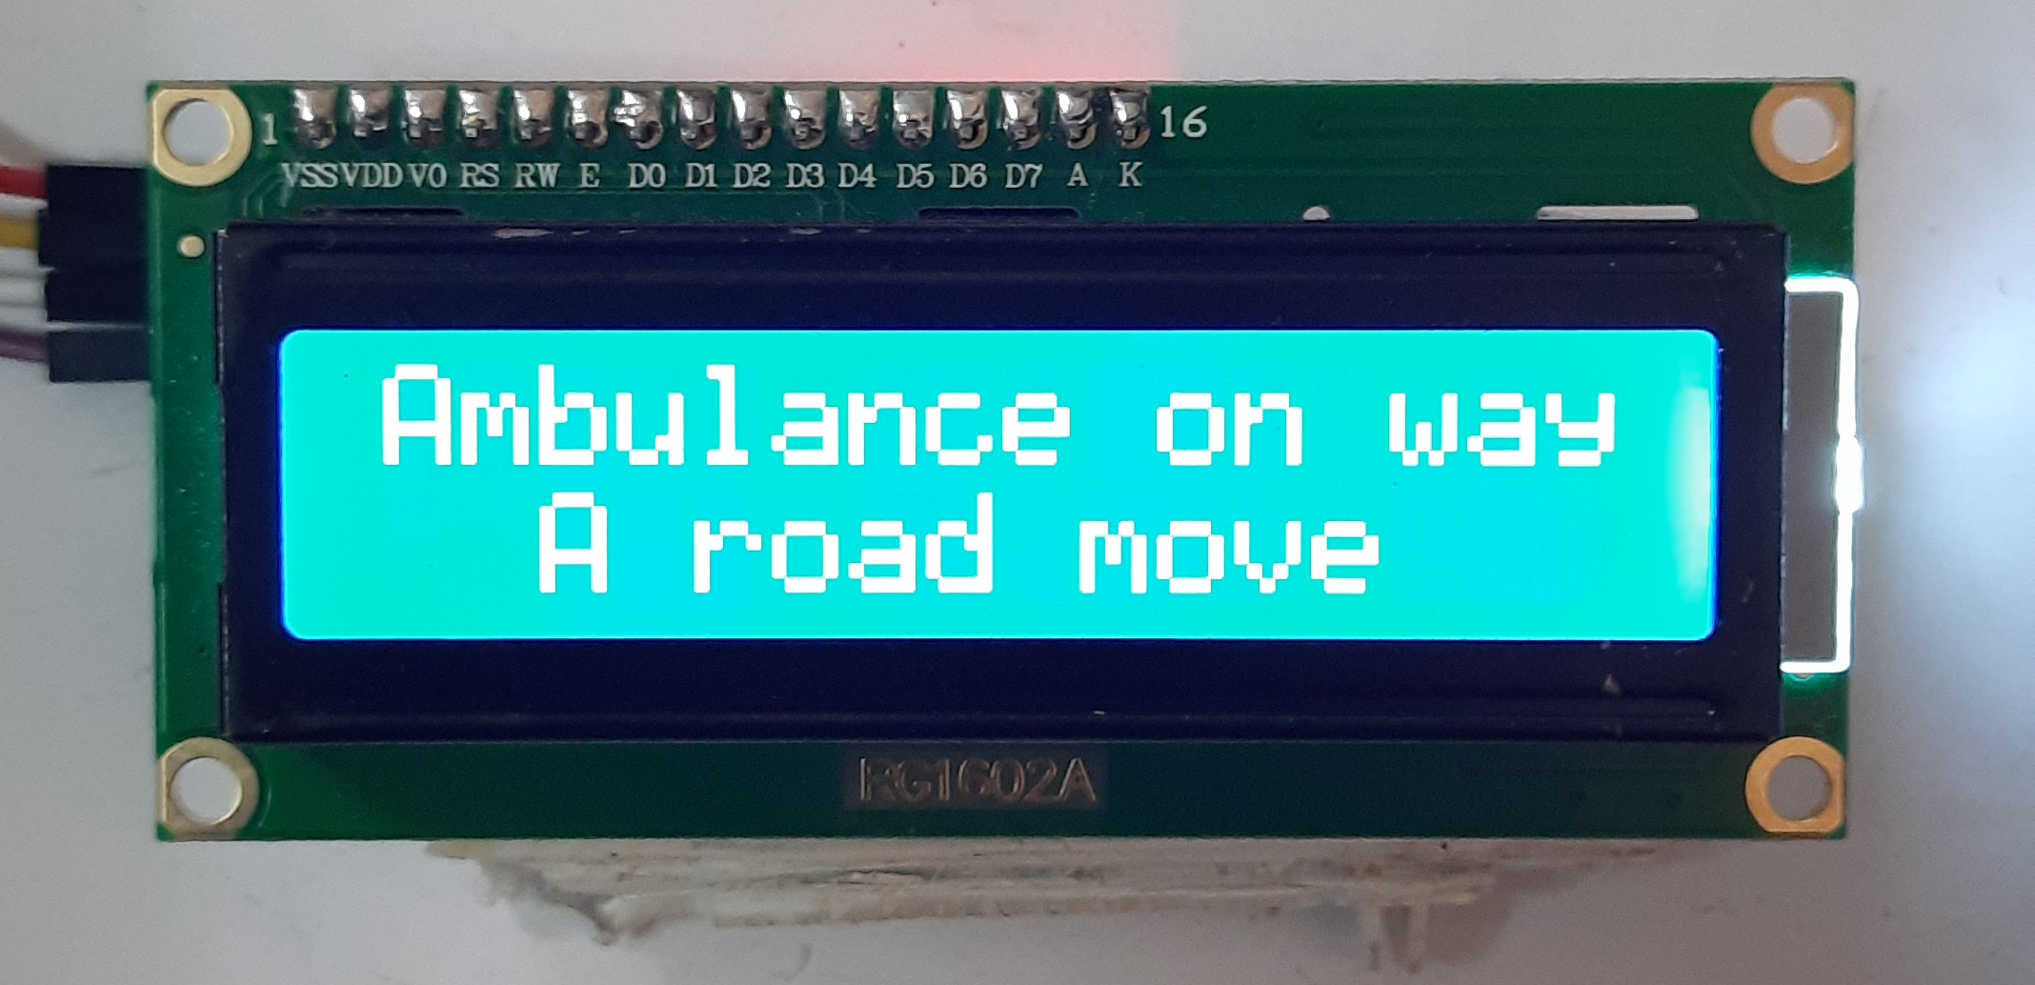
Results
The arrival and prioritizing of ambulance will be displayed in the main signal junction
Ambulance driver receives the nearest hospital location from the ambulance service using GSM module

Slide 14
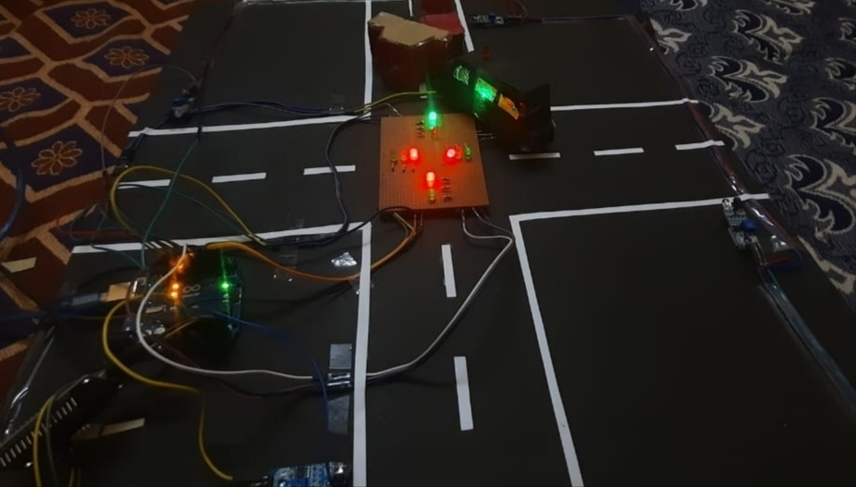
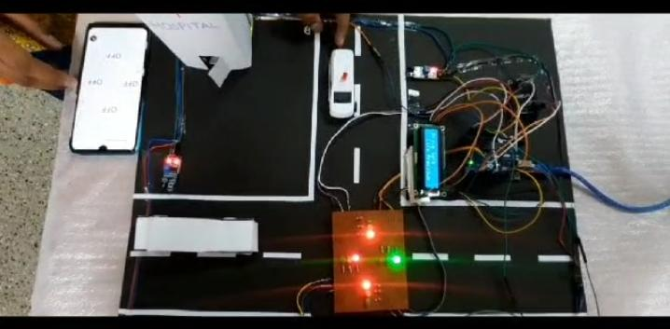
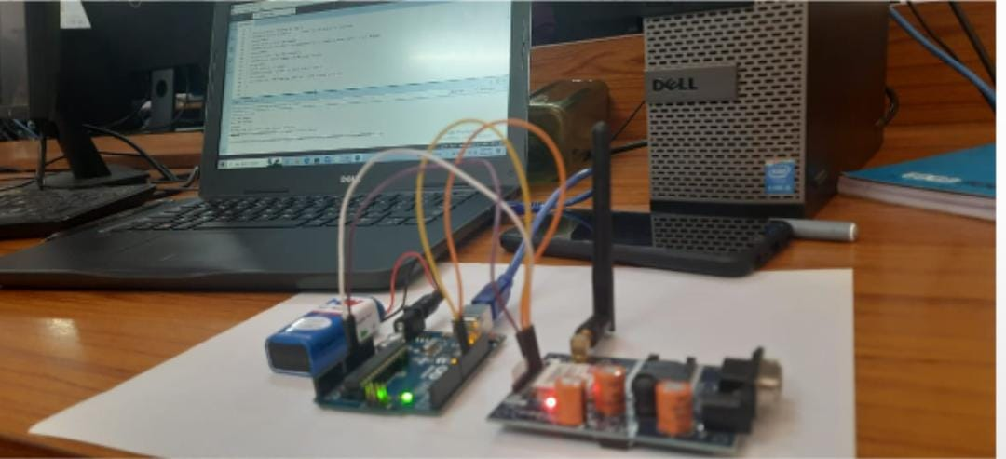
Photographs of project

